Slide 1
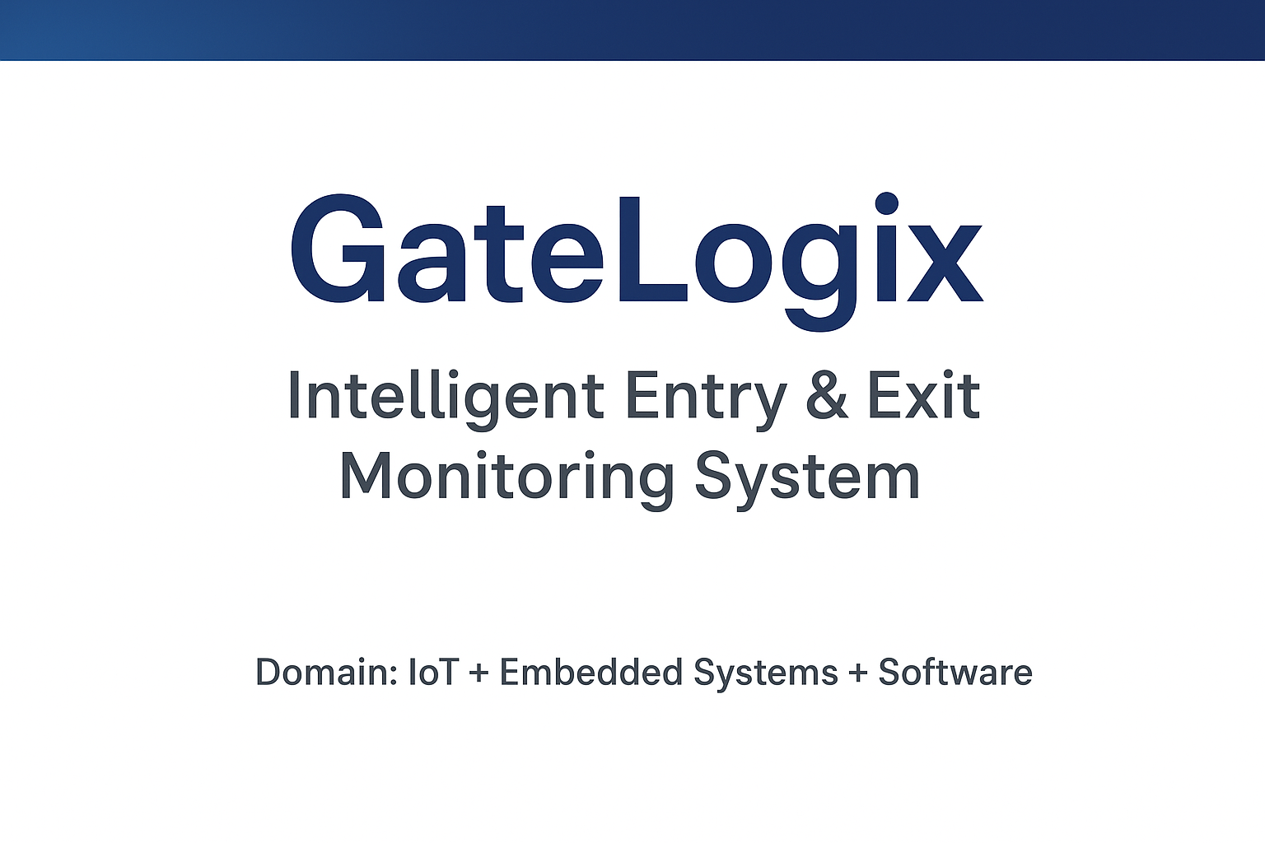
InnoQuest Hackathon 2025
Problem Statement Title-
Domain- IoT & Smart Automation
Team ID- ET04
Team Name- LogicMasters ⚡
Painpoint

Slide 2
Problem Statement:
LogicMasters ⚡
Colleges often face challenges in monitoring student attendance and movement. It is difficult to accurately track when students enter and leave the campus, leading to issues such as inaccurate attendance records, lack of discipline, and administrative inefficiency.
2. Proposed Solution
Install ID scanners at the main gate to record student entry and exit. The data will be stored in a central database and displayed in a mobile/web app for real-time attendance tracking and reports.
3. Technical Approach
Hardware: RFID/QR scanners at entry & exit gates.
Data Flow: Scanned ID → Timestamp → Sent to server.
Database: Stores logs of student entry/exit.
Application: Mobile/Web app shows real-time attendance & reports.
Security: Encrypted data + role-based access.
4. Conclusion
This smart attendance system provides a simple, secure, and efficient way to track student entry and exit. By combining hardware scanning with a mobile application, it ensures accurate records, saves time, and improves overall discipline in the college.
5. References
Research papers on RFID & QR-based attendance systems.
IEEE Xplore: IoT in Smart Campus Management.
Springer Journals on Secure Authentication.
Android & Firebase official documentation.

Slide 3
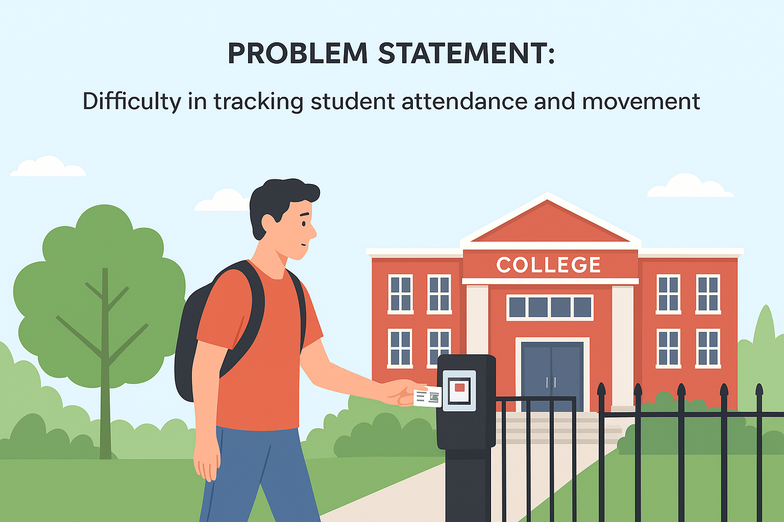
LogicMasters ⚡
Problem Statement
Colleges don’t know exactly when students enter/exit.
Manual attendance is time-consuming and Inaccurate.
Faculty face issues in tracking late comers.
No centralized log for security.
. Lack of transparency in record keeping.

Slide 4
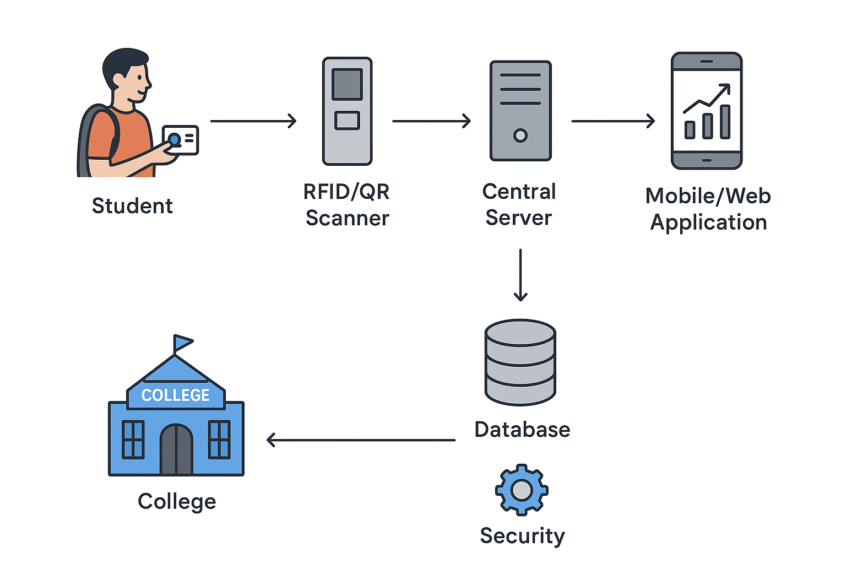
Proposed Solution
LogicMasters ⚡
Hardware Setup: Install RFID/QR scanners at entry & exit gates. Each student uses a unique ID card to log entry and exit with timestamp.
Database & Server: Data is sent to a central server where attendance logs are stored securely and updated in real-time.
Application: A mobile/web app allows staff to view attendance reports and students to check their records.
Security: Encrypted data transfer, role-based access, and offline backup ensure reliability.
Future Scope: Face recognition, AI-based analytics, parent notifications, and ERP integration.

Slide 5
Technical Approach
LogicMasters ⚡
1. Hardware Setup
RFID/QR scanners at main gates.
Students scan ID while entering/exiting.
Scanner captures ID + Timestamp.
2. Data Transmission
Scanner sends data to a Central Server via Wi-Fi/LAN.
Server processes and stores records.
3. Database
All logs stored in secure database (MySQL/Firebase).
Supports real-time data access.
4. Application Layer
-Admin Panel (Web): Attendance monitoring, reports.
-Student App (Mobile): Personal attendance history.
5. Security
Encrypted data transfer.
Role-based access for staff and admin.
Offline backup in case of internet failure.
6. Future Scope
Face recognition integration.
AI-based analytics.
Parent notifications via SMS/Email.

Slide 6
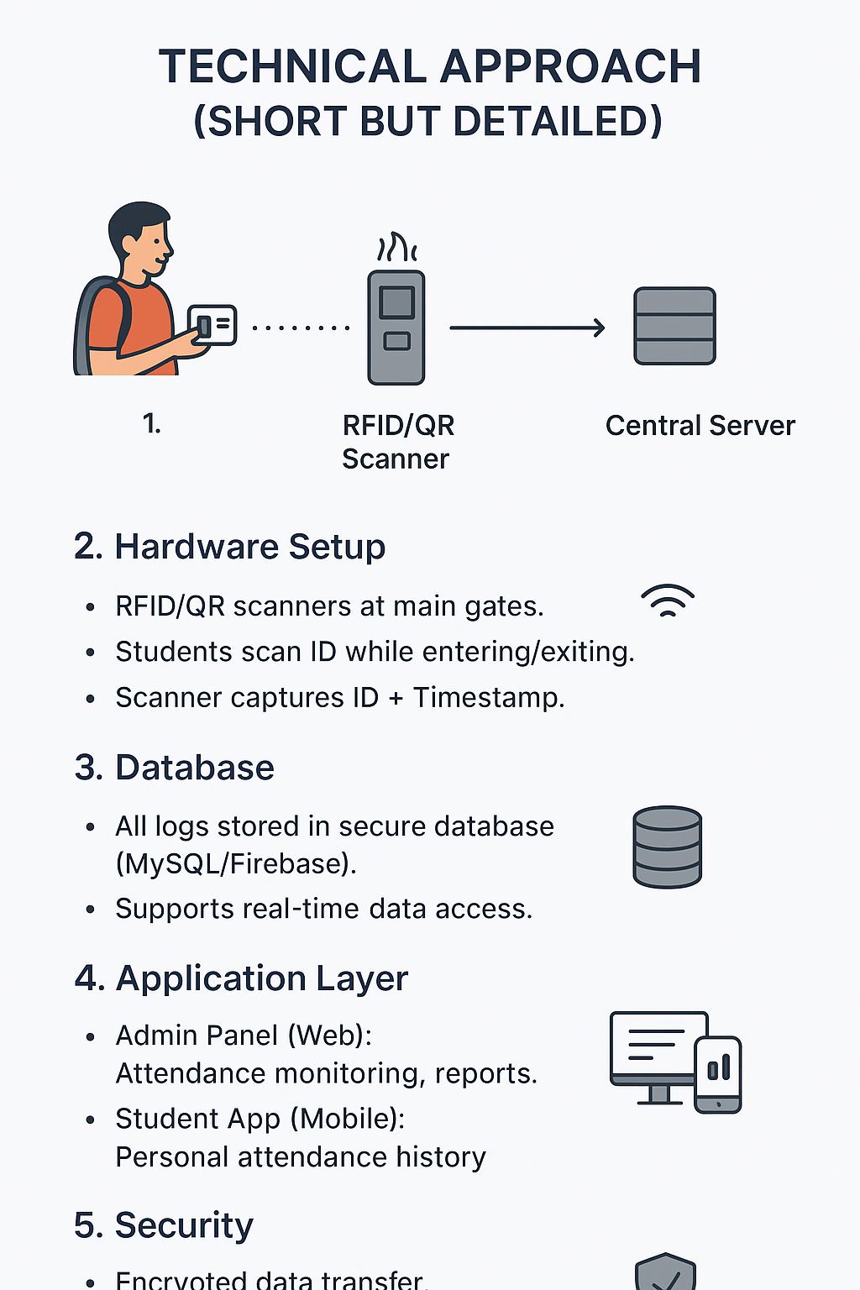
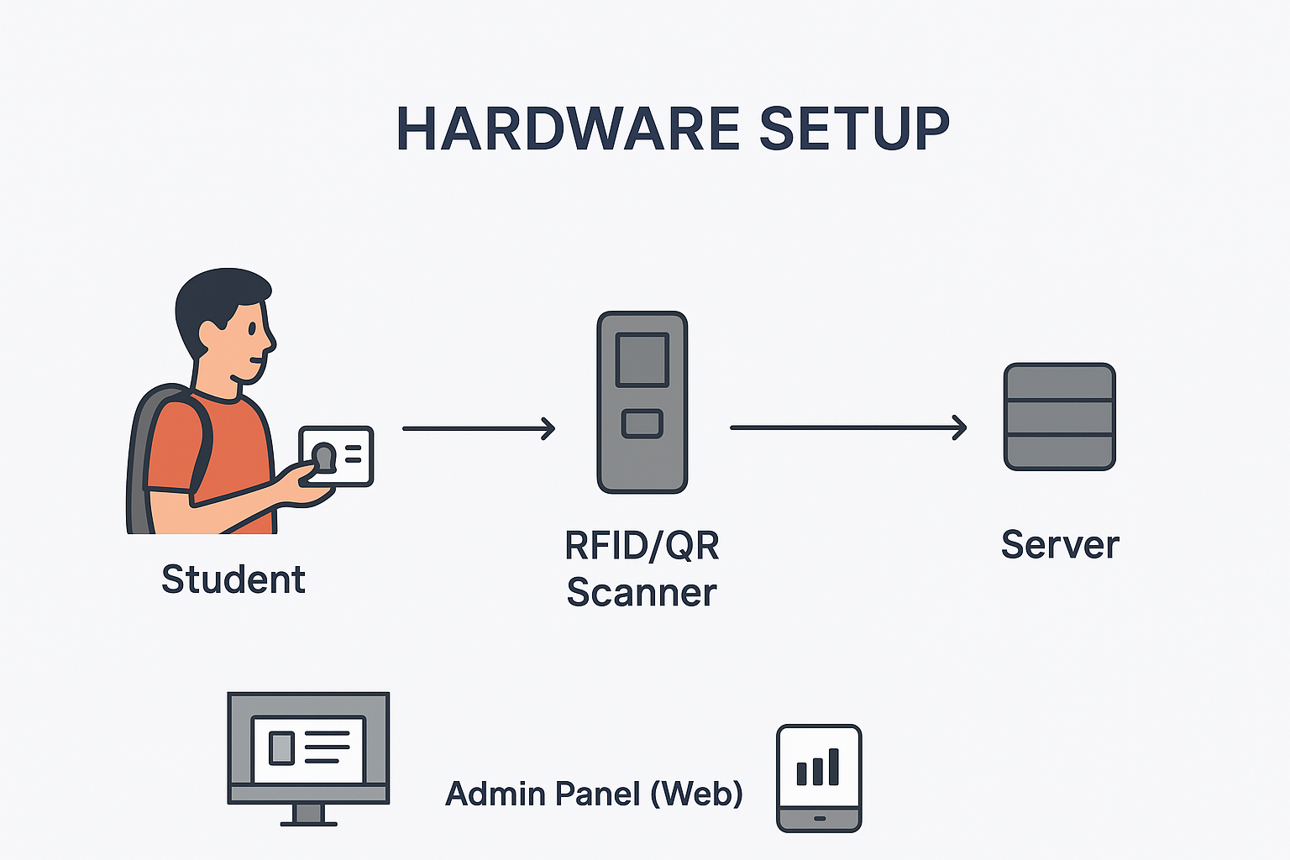
LogicMasters ⚡
Technical Approach

Slide 7
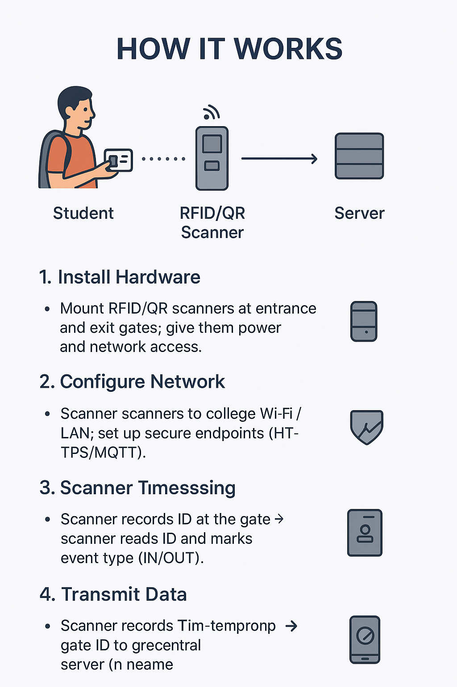
LogicMasters ⚡
How It Works
Student scans ID at gate.
Scanner captures ID + timestamp.
Data sent to central server.
Database stores attendance logs.
Admin checks reports, students view logs.

Slide 8
LogicMasters ⚡
Features
✨ Features of Smart Attendance System:-
🔑 Easy ID Scanning – Students just scan RFID/QR at entry & exit. 📊 Real-Time Attendance – Live tracking of student presence on campus. 📱 Mobile & Web App – Students and staff can access records anytime. 🔒 Secure Data – Encrypted logs with role-based access control. ⚡ Time-Saving – No manual registers, fully automated process. 📢 Instant Notifications – Alerts for late entry, early leave, or absence. 📈 Detailed Reports – Daily, weekly, and monthly attendance analytics. 🔧 Offline Backup – Works even if internet is down, syncs later. 🤖 Future Ready – AI analytics, face recognition & ERP integration.

Slide 9
LogicMasters ⚡
Future Scope
Face Recognition – Attendance without ID card, just by face scan.
Parent Notifications – Parents will get SMS or email if student is absent or late.
AI Analytics – System can show trends like most late students, overall discipline, etc.
ERP Integration – Can be connected with exam system, fee management, and academics.
Cloud Storage – Attendance data can be stored safely online and accessed anytime.
Use in Other Places – Not only colleges, but also offices, hostels, and libraries.

Slide 10
LogicMasters ⚡
Conlcusion
The Smart Attendance System provides a reliable and efficient solution to monitor student entry and exit. By combining hardware scanners with a mobile/web application, it eliminates manual errors, saves time, and ensures transparency in attendance management. With scope for future enhancements like face recognition, AI analytics, and ERP integration, this system can transform campuses into smarter, more disciplined, and technology-driven environments.

Slide 11
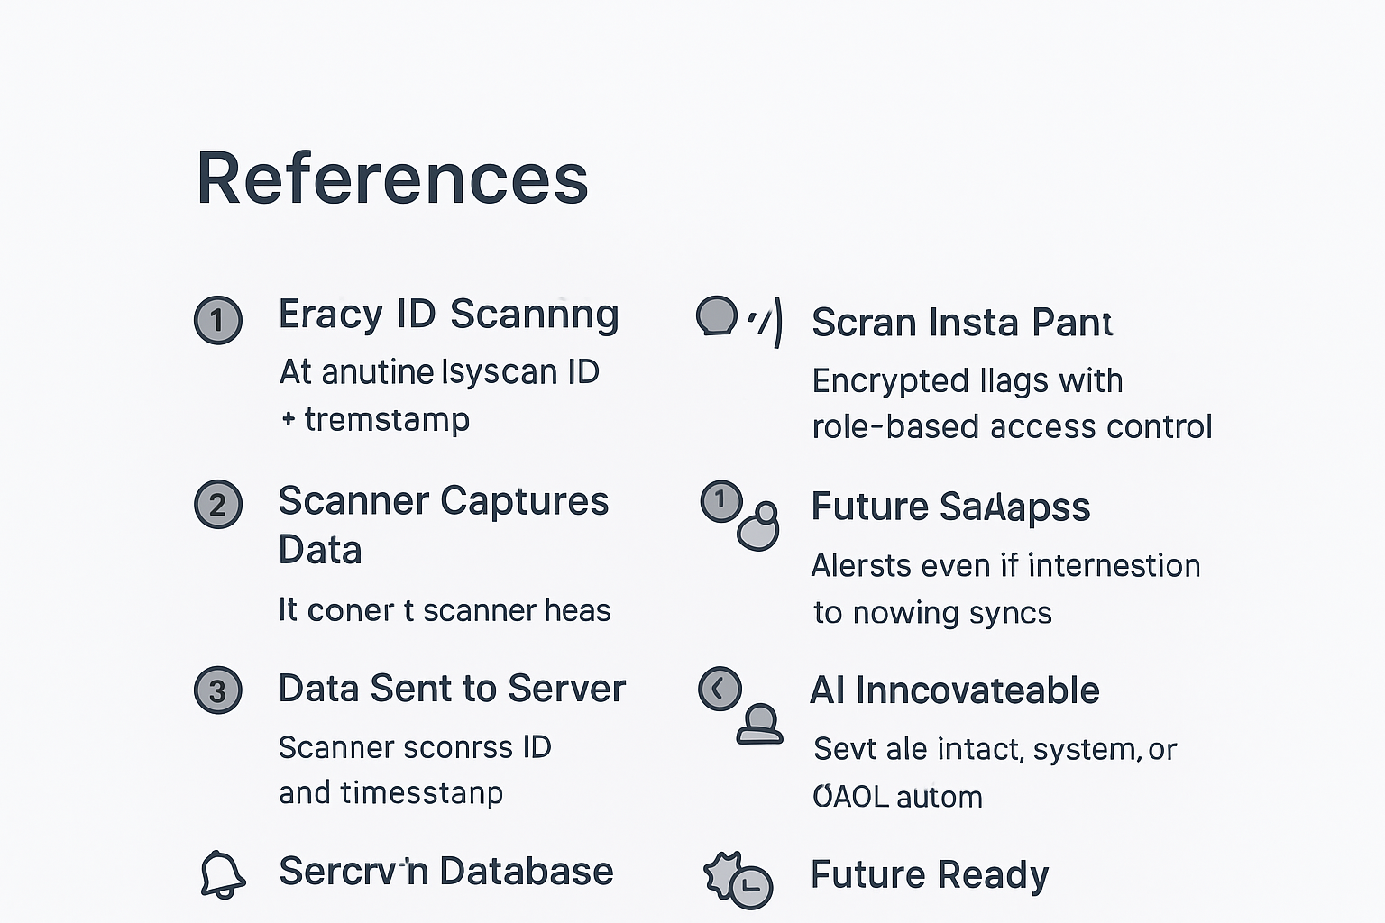
References
LogicMasters ⚡
IEEE Xplore (2023) – IoT Applications in Smart Campus Management.
Springer Journal (2022) – QR Code & RFID Technology for Secure Authentication.
Android Developers Documentation – Mobile Application Development Frameworks.
Firebase & MySQL Documentation – Database Management Systems.
RFID Based Attendance Systems – Research papers and case studies on automation in education.

Slide 12
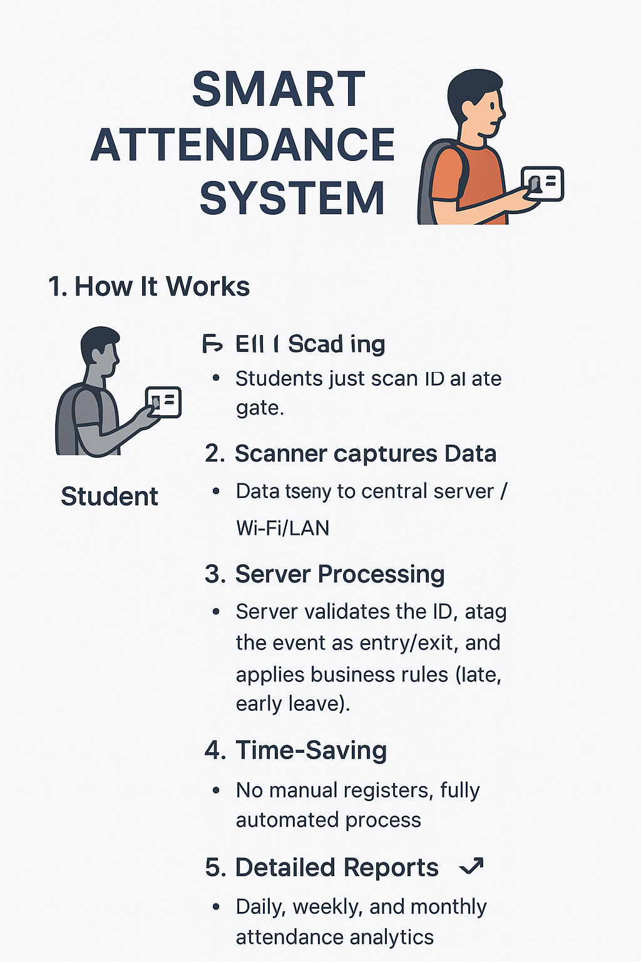

Slide 13


